Slide 1
Lecture 6: Prediction with mixed effects models

Slide 2
This lecture
Making predictions for new values (fixed and random effects included)
Making confidence intervals around predictions
(all in the context of normal response data)

Slide 3
Predictions with linear models (lm)
Predictions of the model for the data used to fit the model is provided by > fitted(model)
Predictions for new data are provided by > predict(model, newdata=newdata)
Can get confidence intervals with > predict(model, newdata=newdata, interval=‘confidence’, level=0.95)
Name of new data set
Model name
Width of interval
Type of interval

Slide 4
Code 6.1
lm model predictions

Slide 5
Predictions with lmer
predict() function an option BUT no confidence intervals given
> predict(mod, newdata=mynewdata, re.form=~0)
New predictor values
Which random effects do you want?
NULL = everything in model
~0 = no random effects, only fixed
~group = specify the groups you want

Slide 6
Code 6.2 part 1
lmer Model predictions

Slide 7
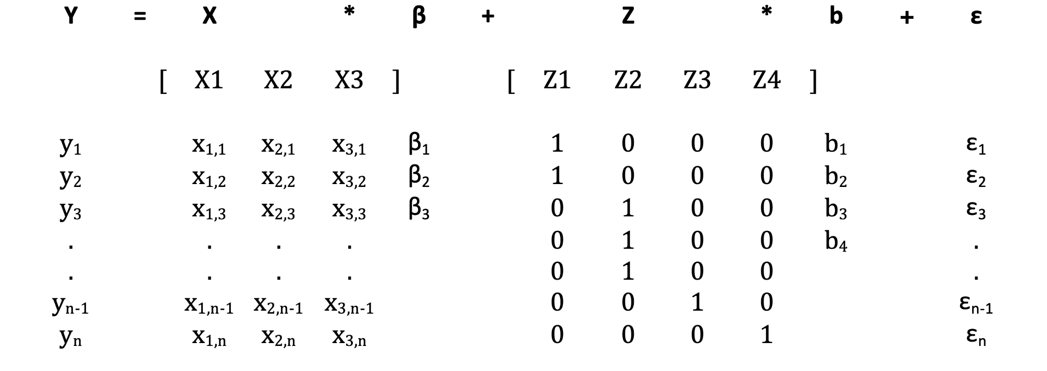
Recall: y_{i} = X_{i}β + Z_{i}b_{i} + ε_{i} expanded
=
+
+
(px1)
(qx1)
(nx1)
(nxp)
(nxq)
(nx1)

Slide 8
Matrix calculations (‘by hand’)
Fixed effects part: Y = Xβ
In R code this as Y = X %*% beta
Can get beta from the fixed effects
Need to create X – use model.matrix() command

Slide 9
model.matrix()
model.matrix makes a model matrix given a formula and a data set
Only need the right hand side of the formula e.g. model.matrix(~x1+x2+ x3*x4, data=dat)
Automatically expands factors
Make sure the formula in model matrix is EXACTLY the same as in your model

Slide 10
Making predicted values
Once you have your model (mod) and model matrix (mat), do pred <- mat %*% fixef(mod)
Ignores random effects. To add them, add the appropriate BLUP
e.g. to add the data from block ‘3’ do
pred <- mat %*% fixef(mod) + ranef(mod)$block[‘3’,]
This works for simple mixed effects models…

Slide 11
Code 6.2 part 2
lmer Model predictions

Slide 12
Confidence intervals
This is tricky .
Need to extract the variance-covariance (VCV) matrix for the fixed effects with vcov(mod)
Then calculate the standard errors for the predictions as: se = (X * VCV * X^{t})^{1/2}
Do this in R with pred.se <- sqrt(diag(mat %*% vcv %*% t(mat)))
Model matrix

Slide 13
Confidence interval for a new shadehouse
It is more uncertain when you predict in a new shadehouse.
So have to add extra variation – get this from the variance among groups.
E.g., if there is a random effect for shadehouse, do
pred.se.new <- sqrt(diag(
mat %*% vcv %*% t(mat) +
VarCorr(mod)$shadehouse[1]))

Slide 14
Getting the right predictions and standard errors
 | Mean | Variance
Known group | fixed effect + group effect | Fixed effect
Unknown group | Fixed effect | Fixed effect + group effect

Slide 15
Code 6.3
Confidence intervals

Slide 16
Exercise 6.1
Use the biodepth data (biodepth.csv) to estimate the relationship between biomass and log(diversity)
Use lme4’s inbuilt functions to estimate
The expected biomasses at an unknown site
The expected biomasses at the Swiss site
Now repeat this by hand!
Can you get the same answers?

Slide 17
Exercise 6.2
Calculate the standard errors for the predictions you just made
Now calculate the confidence intervals.
Remember that new block = more uncertainty

